Slide 1


GED 405-CSE(201)
Industrial and Operational Management
Course Instructor
Topic: Copyright ©
PRESENTED BY
Samayun Miah Chowdhury (222015031)
Rakibul Islam (213015028)
Rimon Ahammad (221015018)
Mehedi Hasan (222015040)
Al Imran (201015089)
Nusrat Jahan
Lecturer, MIS &
Assistant Program Coordinator
Green University of Bangladesh

Slide 2
CSE 303-CSE(181)
Table of Contents
GED 405-CSE(201)
Topic
Page
What is copyright © ? 3
Why is copyright important? 4
What Works are Protected by Copyright in Bangladesh? 5
Copyright Registration in Bangladesh 6
Copyrightable works & Duration 12
Non-copyrightable works 13
Things to know before using the copyright works 14
Fair uses of works are 15
Alternatives to Standard Copyright 16
Limitation of copyright 17
Conclusion 18
Page: 2

Slide 3

GED 405-CSE(201)
WHAT IS COPYRIGHT © ?
Copy Right Act, 2000 ,Bangladesh
Page: 3

Slide 4
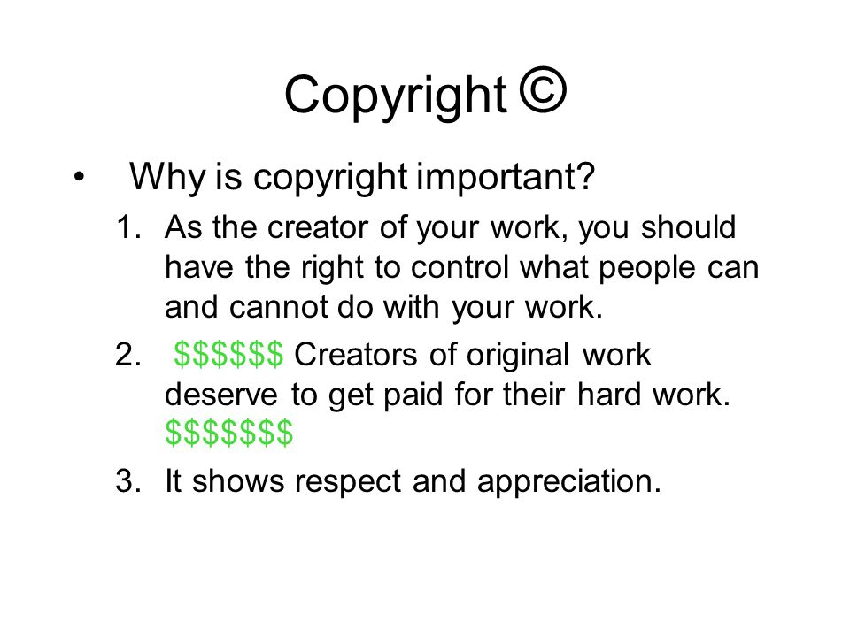
GED 405-CSE(201)
Page: 4

Slide 5
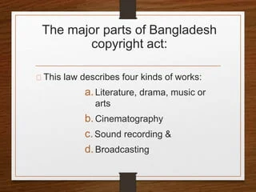
GED 405-CSE(201)
What Works are Protected by Copyright in Bangladesh?
Figure Source
Page: 5

Slide 6
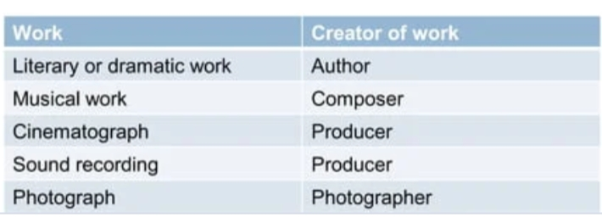
GED 405-CSE(201)
Whose Rights are protected?
Copyright protects the right of Author,creator of Intellectual Properties.
He/She is also called the First Owner of Copyright.
In course of employment, the employer is the first owner of these rights.
Page: 5

Slide 7

GED 405-CSE(201)
National Vs International Copyright
1. No single "international copyright" for whole world.
2.The Copyright Act of each country is compliant with most international conventions and treaties.
3.In India, the Copyright Act, 1957 is compliant with these international conventions and treaties-
(a) Berne Convention of 1886
(b)Universal Copyright Convention of 1951
(c)Agreement on Trade Related Aspects of Intellectual Property Rights (TRIPS)

Slide 8

GED 405-CSE(201)
Indian Copyright Act, 1957
1.The Copyright Act of 1957 offers a comprehensive definition of literary work.
2.Encompassing elements such as computer programming, documents, and compilations, which also include computer databases.
3.It also includes the written or recorded elements of scenic arrangements and acting forms.
4.According to the Copyright Act, 1957, Artistic works encompass a wide range of creations, including paintings, sculptures, drawings engravings, and photographs.

Slide 9
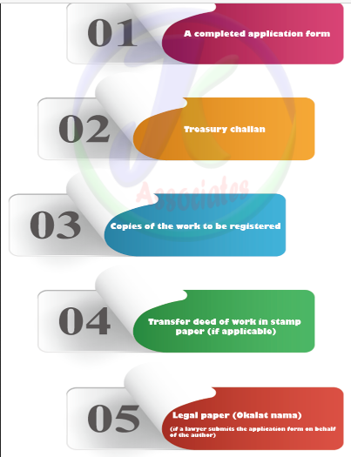
GED 405-CSE(201)
Copyright Registration in Bangladesh

Slide 10
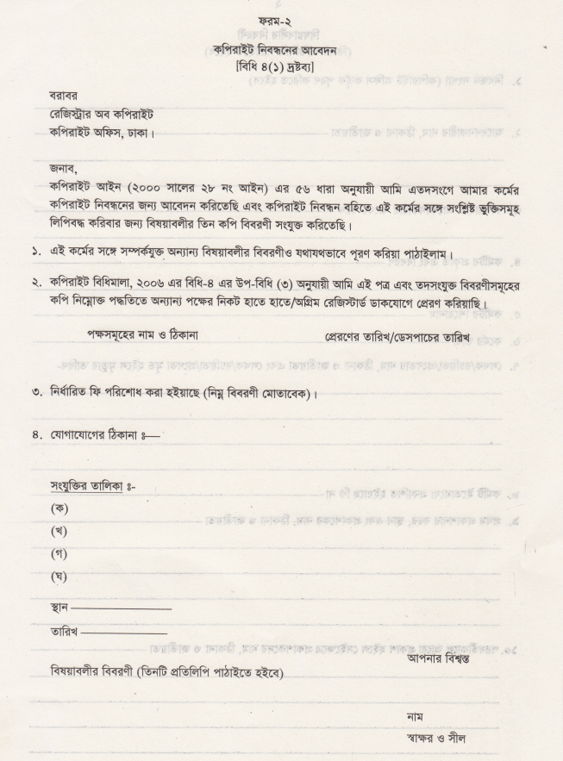
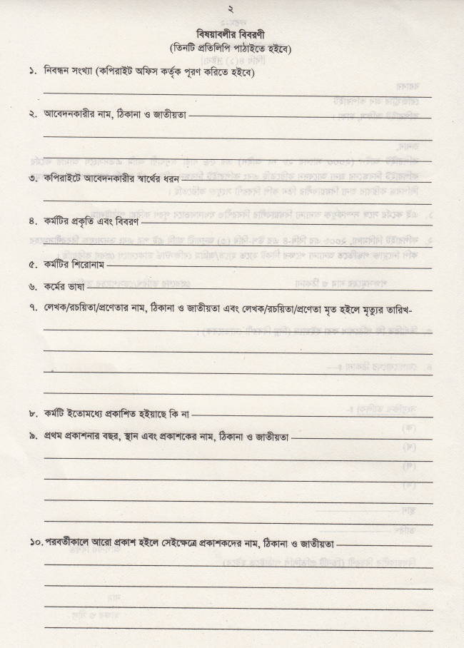
1. Identify Your Work
2. Prepare Necessary Materials
3. Copyright Office in Bangladesh
4. Application Form
5. Submit the Application

Slide 11
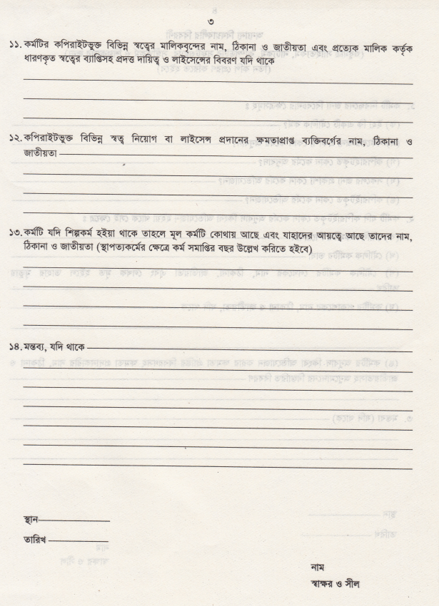
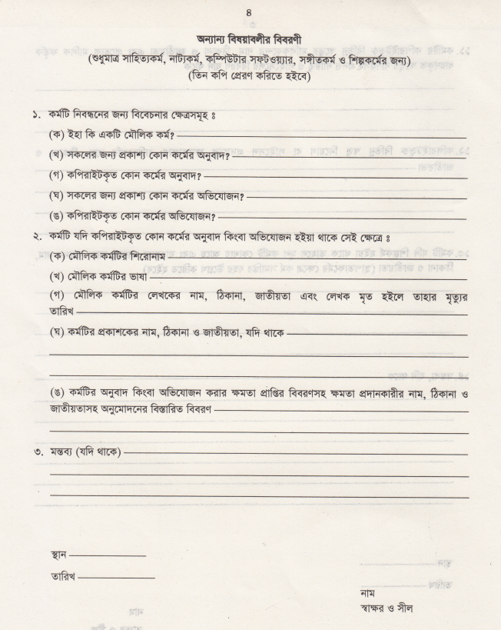
6. Pay the Fee
7. Wait for Processing
8. Copyright Certificate
9. Enforce Our Rights

Slide 12

GED 405-CSE(201)
Copyrightable works & Duration
Artistic works, including photographs
Dramatic works
Literary works
Musical works

Slide 13
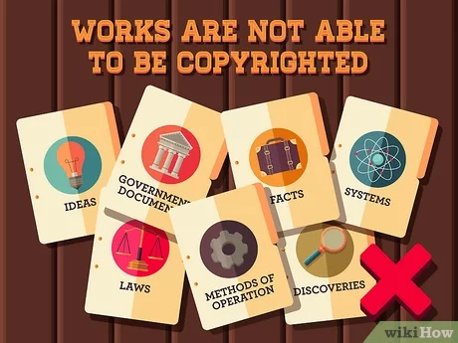
GED 405-CSE(201)
Non-copyrightable works
Facts
Ideas
System or
Methods of operation

Slide 14

GED 405-CSE(201)
Things to know before using the copyright works
Check who owns it
Get a permission to use it
Give credit to the creator
But it (if necessary)
Use it responsibly

Slide 15
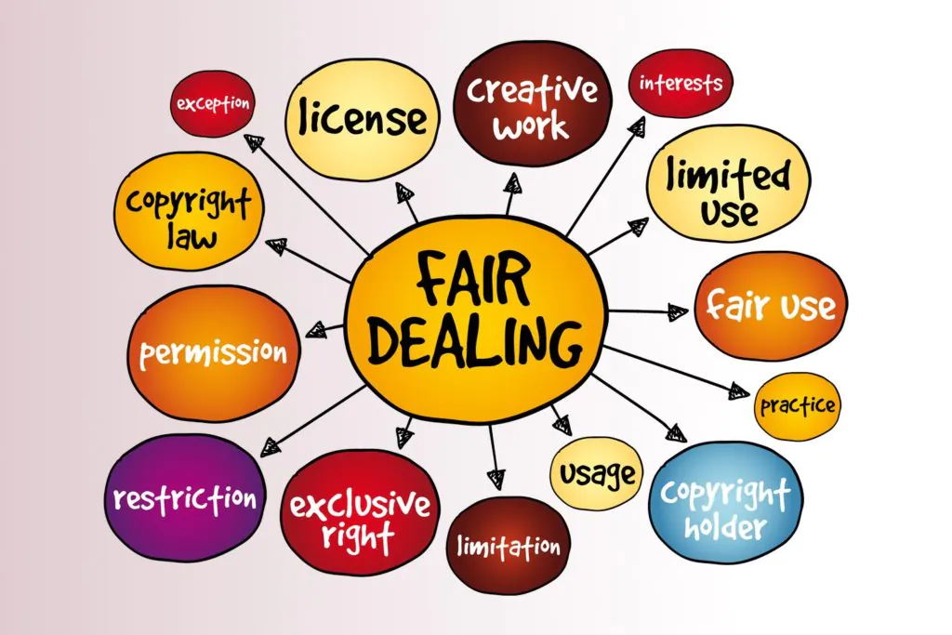
GED 405-CSE(201)
Fair uses of works are
School work and education
News reporting
Criticising or, commenting
Comedy or parody

Slide 16

GED 405-CSE(201)
Alternatives to Standard Copyright
Licenses
Creative Commons Licenses
Public Domain
GNU

Slide 17
GED 405-CSE(201)
Limitation of copyright
Generally, copyright protection under American law protects the copyright holder for the duration of the life of the author plus 70 years
Copyright also has disadvantages, such as limitations on user rights, potential barriers to entry, and enforcement complexities.

Slide 18
GED 405-CSE(201)
conclusion
In conclusion, copyright is a crucial aspect of intellectual property protection, playing a pivotal role in fostering creativity, innovation, and the fair distribution of knowledge. Throughout this presentation, we've explored the fundamental principles of copyright law, its historical evolution, and the key components that define the rights and limitations of creators.

Slide 19

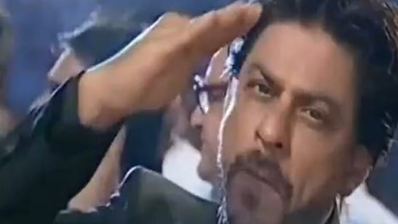
GED 405-CSE(201)
Industrial and Operational Management
The End

